Slide 1

Predicting Wine Quality A Comparative Analysis of Classification Methods
By:-
Jayesh Pamnani
808L Final Project
Fall 2023

Slide 2
Agenda
Introduction
Importance of Wine Quality Assessment
Data Set
Decision Problem – Predicting Wine Quality
Methodology
Machine Learning Algorithms Used
Performance Metrics
Results
Accuracy Summary
AUC-ROC & Confusion Matrix
Discussion
Algorithm Selection
Strategic Decision Making
Final Decision
Future Work

Slide 3
Introduction: Importance of Wine Quality Assessment
Consumer Assurance:
Aligning choices with preferences
Producer Imperative:
Fostering brand reputation and customer loyalty

Slide 4
Introduction: data set
Source: UCI Machine Learning Repository and Kaggle.
Size: Approximately 1600 samples.
Features: Chemical properties crucial to wine quality.
Fixed acidity, volatile acidity, citric acid, residual sugar, chlorides, free sulfur dioxide, total sulfur dioxide, density, pH, sulphates, alcohol.
Target Variable: Quality (binary classification - good or bad).

Slide 5
Introduction: Decision Problem in Wine Quality Prediction
Multifaceted Challenge: Predicting "good" or "bad" classification.
Stakeholders: Empowering consumers and aiding producers.
Complexity: Exploration of 5 machine learning algorithms.
Study Objective: Identify the most effective method for prediction.

Slide 6
METHODOLOGY: machine learning algorithms used
Five machine learning models are used in the study and are trained on 67% of the dataset:
Decision Tree
Logistic Regression
k-Nearest Neighbors
Naïve Bayes
Linear Discriminant Analysis

Slide 7
Methodology: performance metrics
Evaluation Metric: Accuracy.
Consistency across models, facilitating direct comparison.
Cross-Validation: Employed a 3-fold cross-validation.
Ensures generalization and robustness of models.
Area Under the ROC Curve (AUC-ROC):
Provides insights into true positive and false positive rates.
Confusion Matrix:
Resolving tiebreakers between the top 2 models.

Slide 8
Results: accuracy summary
MODEL | ACCURACY | CROSS-VALIDATION MEAN ACCURACY
DECISION TREE | 69.12% | 69.40%
LOGISTIC REGRESSION | 73.48% | 72.74%
K-NN | 66.85% | 67.91%
NAÏVE BAYES | 53.21% | 56.54%
LINEAR DISCRIMINANT ANALYSIS | 73.29% | 72.84%

Slide 9
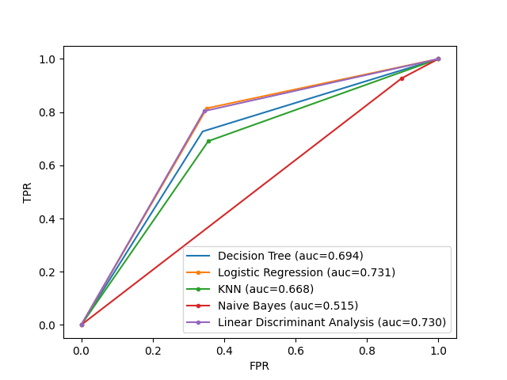
RESULTS: AUC-ROC & CONFUSION MATRIX
Confusion matrix for Logistic Regression:
[[164 87]
[ 51 224]]
Confusion matrix for Linear Discriminant Analysis:
[[166 85]
[ 54 221]]

Slide 10
Discussion: algorithm selection
Logistic Regression and Linear Discriminant Analysis (LDA) were chosen.
Comparable accuracy scores, leading to nuanced decision-making.
Comparable Area under Receiver Operating Characteristic-Curve
Comparable Confusion Matrices

Slide 11
Discussion: Strategic Decision-Making: Minimizing False Positives vs. False Negatives
Customer Satisfaction
Minimizing false positives is crucial for customer retention.
Preserves brand loyalty and potentially increases revenue
Quality Preservation
Minimizing false negatives is essential to avoid undervaluing premium products.
Incorrectly classifying high-quality wines as lower quality can impact brand reputation and revenue.
Companies may lean towards models that align with specific business priorities.

Slide 12
Discussion: final decision
Logistic Regression (LR) is identified as more computationally efficient.
Faster processing and reduced computational resources compared to Linear Discriminant Analysis (LDA).
Despite comparable accuracy, area under ROC-Curve and confusion matrix with LDA, LR's computational efficiency tips the scale.

Slide 13
Discussion: future work
Advanced Techniques: Explore advanced feature engineering techniques for a richer understanding of wine quality predictors.
Dataset Enhancement: Increase dataset size with diverse samples for more comprehensive analysis.
Algorithmic Exploration: Experiment with advanced algorithms and tuning to boost predictive performance.
Industry Collaboration: Collaborate with wine industry experts for real-world insights.

Slide 14

Cheers!

